Slide 1
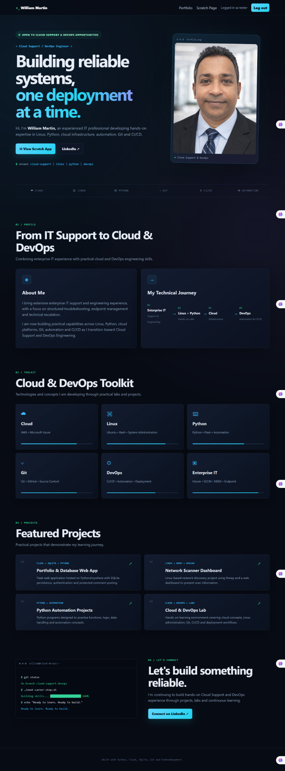
PORTFOLIO PRESENTATION
From IT Support
to Cloud & DevOps
William Martin
Enterprise IT • Endpoint Management • Cloud • DevOps
16+ YEARS IT EXPERIENCE
SCTP CLOUD SUPPORT & DEVOPS
My story
Enterprise Support → Hands-on Cloud → DevOps
I am building on my existing troubleshooting experience rather than starting from zero.
MY PORTFOLIO WEB APPLICATION
1/5
Notes:
SLIDE 1 — ~35 seconds
“Good morning everyone. My name is William Martin.
I have more than 16 years of IT experience, mainly across enterprise support, endpoint management, troubleshooting and infrastructure support.
For me, this portfolio represents a career transition. I am taking the experience I already have in solving technical problems and applying it to Cloud and DevOps.
Over the next few minutes, I’ll show you where I came from, what I have been building, what I learned from the process, and where I want to go next.”
PAUSE.
“Let’s start with the experience I already bring to the table.”

Slide 2
01 / EXPERIENCE
What I Bring to the Table
A strong enterprise foundation, now extended with Cloud & DevOps skills.
CAREER FOUNDATION
SKILLS I CAN DEMONSTRATE
2010–2018
Enterprise IT Support
Desktop support, migrations, deployments, asset lifecycle & project rollouts
ENTERPRISE IT
ENDPOINT
L3 support • RCA • escalations
Customer integrations • documentation
Intune • SCCM • Jamf
Microsoft 365 • Azure AD
2019–2021
EUC / Endpoint Engineering
Intune, Azure AD, SCCM, MDM, macOS/iOS & VIP support
2021–2026
3rd Level Support
Complex escalations, RCA, customer integrations & engineering collaboration
CLOUD & DEVOPS
HOW I WORK
2026 →
Cloud & DevOps
Azure • Linux • Git • Docker
Terraform • Ansible • CI/CD
Troubleshoot methodically
Communicate • collaborate • document
Python, Linux, Git, Docker, Azure, Terraform, Ansible & CI/CD
2/5
Notes:
SLIDE 2 — ~60 seconds
“My biggest differentiator is that I am not starting my IT career from zero.
I started in enterprise IT support and infrastructure roles, then moved into EUC and endpoint engineering, and most recently worked in third-level support.
In my 3rd Level Support role, I dealt with complex escalations, root-cause analysis, customer integrations and engineering collaboration.
Technically, my background includes Intune, SCCM, Jamf, Microsoft 365, Azure AD, Windows and macOS.
Now I am extending that foundation through Cloud and DevOps training — including Linux, Python, Git, Docker, Azure, Terraform, Ansible and CI/CD.
The important point is that troubleshooting, communication and documentation are skills I can carry from support into Cloud and DevOps.”
Transition:
“And the best way to demonstrate that is with something I actually built.”

Slide 3
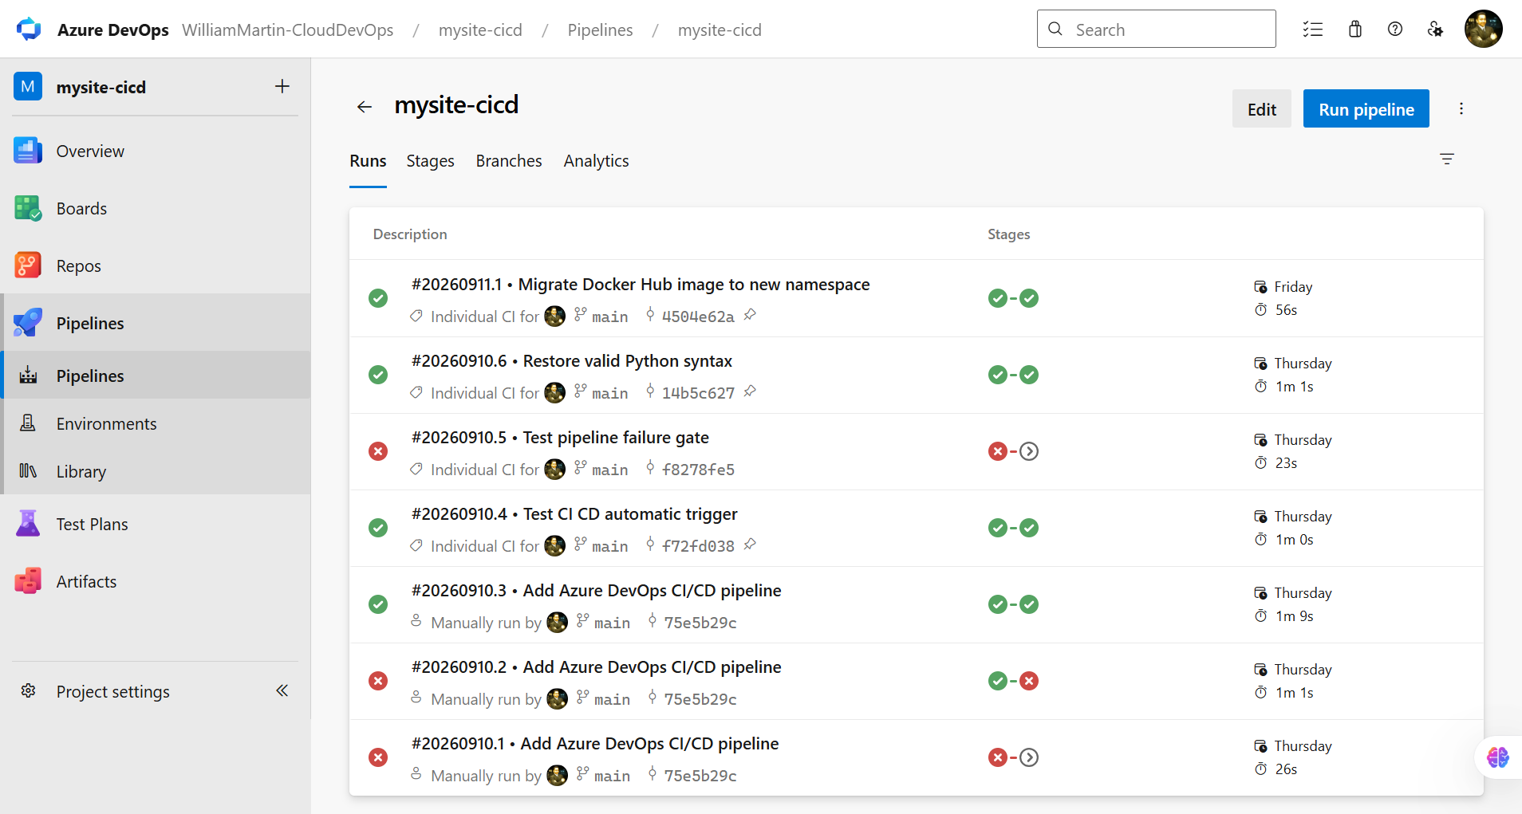
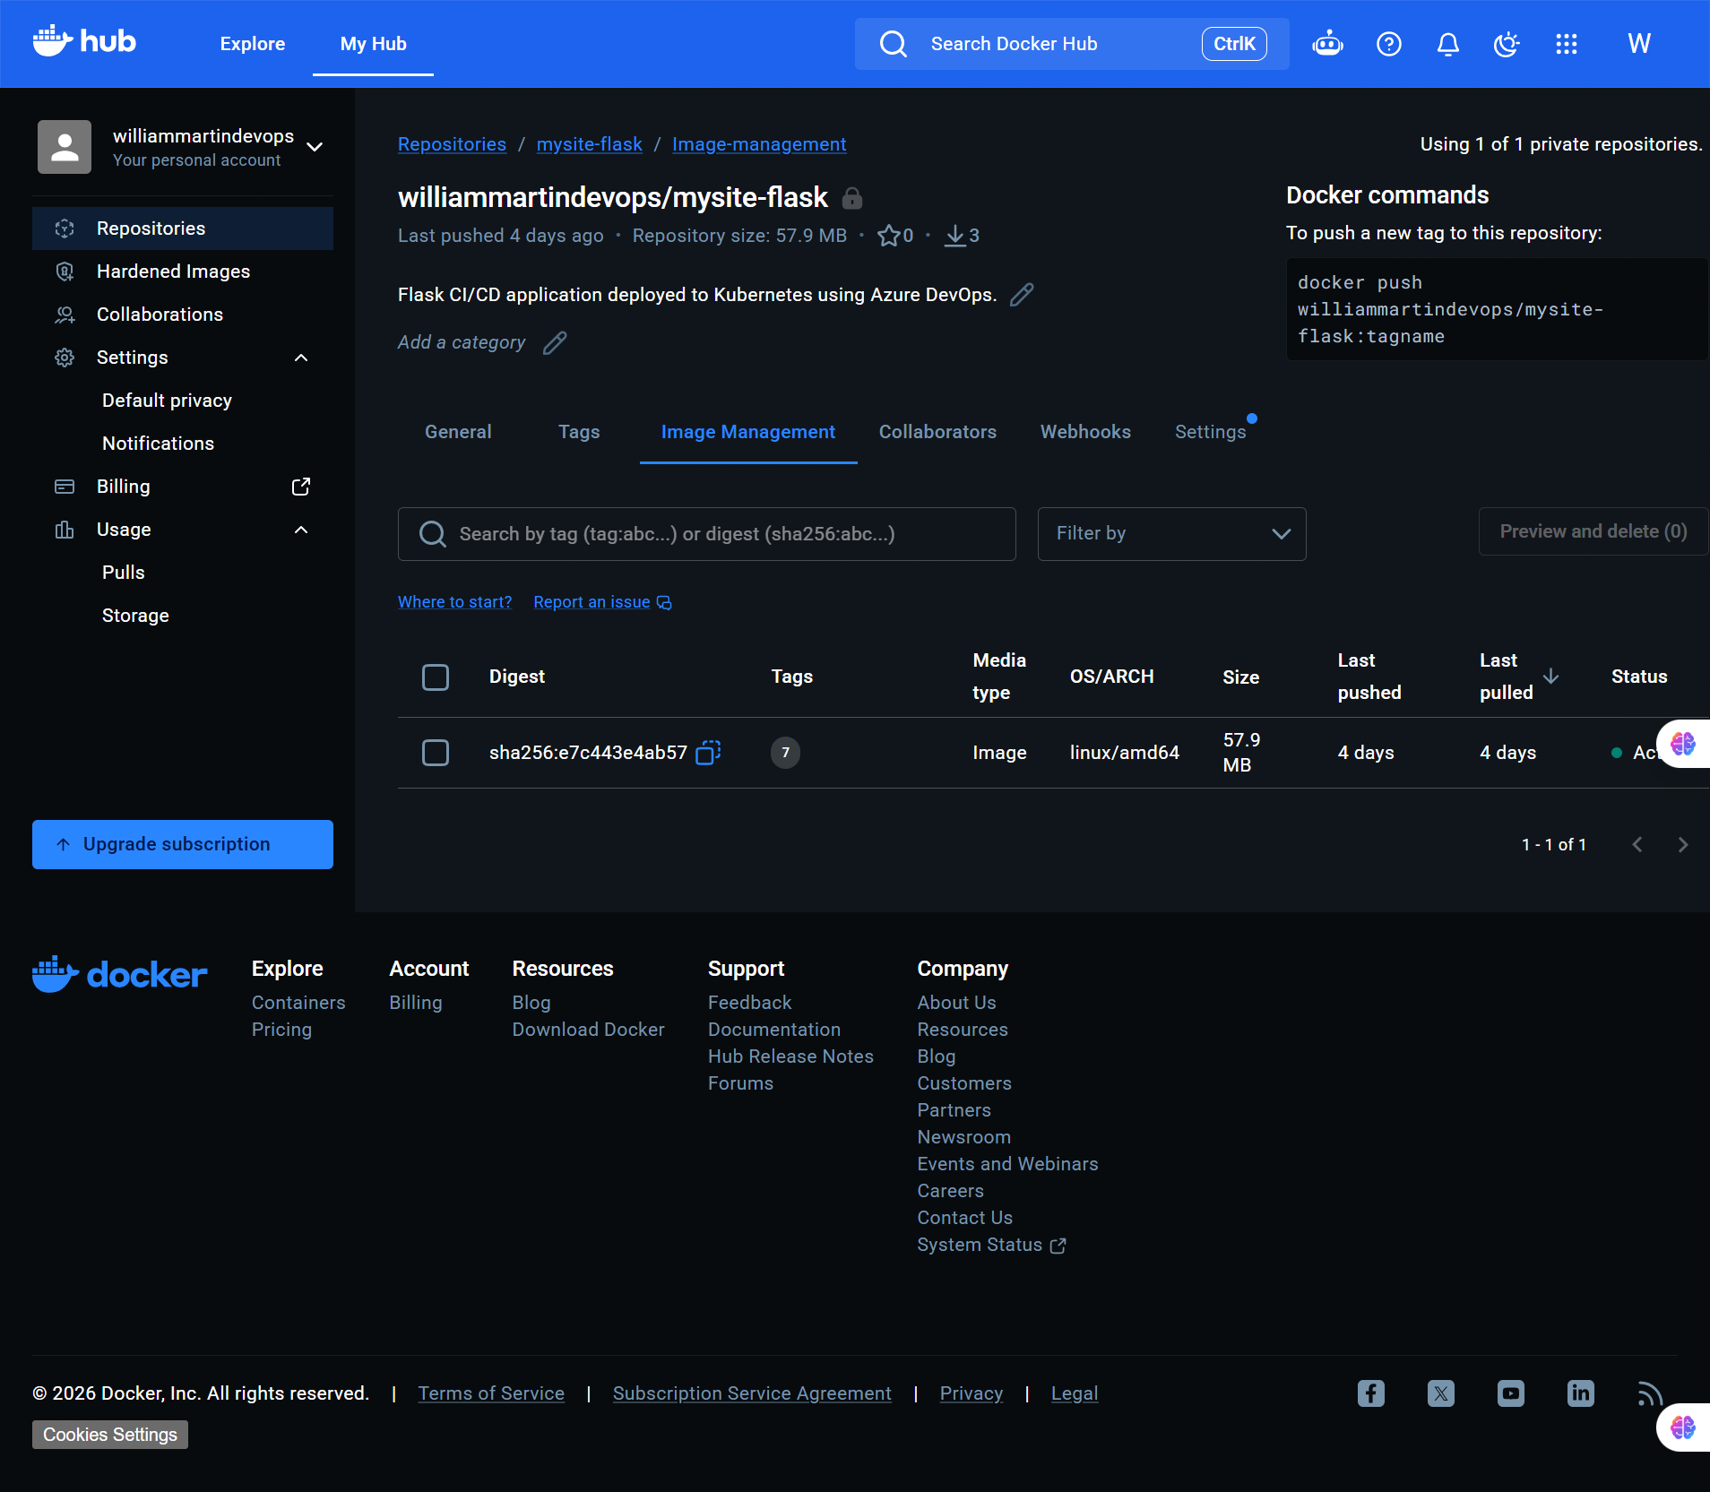
02 / PROJECT
A CI/CD Pipeline I Built
From a Python Flask application to a container running on Kubernetes.
1
Flask App
→
2
Git / Source
→
3
Azure DevOps
→
4
Docker Image
→
5
Kubernetes
PIPELINE EVIDENCE
CONTAINER EVIDENCE
Azure DevOps shows successful runs, automatic trigger testing and a deliberate failure gate.
The private Docker Hub repository contains the application image used by the deployment workflow.
3/5
Notes:
SLIDE 3 — ~95 seconds
“One of the strongest pieces of evidence in my portfolio is this CI/CD project.
I started with a Python Flask web application. I then containerised the application with Docker and created a pipeline in Azure DevOps.
The basic flow is: application source, source control, CI/CD pipeline, container image, and finally deployment to Kubernetes.
What makes this project useful for my portfolio is that I can show evidence rather than simply list technologies.
On the left is my Azure DevOps pipeline. You can see successful runs, testing of the automatic trigger, and also a deliberate pipeline failure gate.
On the right is the private Docker Hub repository containing the container image.
I learned that CI/CD is not just about making a green pipeline. It is about creating a repeatable process where changes can be built, checked and deployed.
I also had to troubleshoot the project along the way, which brings me to the part I found most valuable.”
PAUSE before moving on.

Slide 4
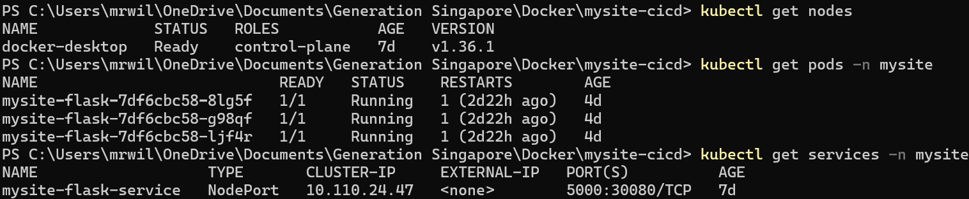
03 / LEARNING
What Went Wrong — and What I Learned
The troubleshooting process was as valuable as getting the application to work.
TROUBLESHOOTING STORY
KUBERNETES EVIDENCE
CHALLENGE
Pipeline and deployment issues required investigation rather than guesswork.
ACTION
Read the errors, checked the pipeline stages, verified the container and inspected Kubernetes.
RESULT
The Flask application was running in Kubernetes and returned HTTP 200 during testing.
3/3 Flask pods running
Service exposed as NodePort 5000:30080/TCP
My support background helped here:
Test result: HTTP 200 OK
reproduce → read → inspect → isolate → fix → verify
4/5
Notes:
SLIDE 4 — ~65 seconds
“One of the biggest areas of growth for me was learning to troubleshoot technologies I was still becoming familiar with.
During this project, I encountered pipeline and deployment issues. Instead of treating the error as something to work around blindly, I used the troubleshooting approach I already developed in IT support.
I reproduced the problem, read the error, inspected the relevant component, isolated the issue, applied a fix and then verified the result.
The Kubernetes evidence here shows three Flask pods running, with the application exposed through a NodePort service.
I also tested the deployed application and received an HTTP 200 response.
That was an important lesson for me: the tools may change, but the problem-solving mindset remains the same.
I am now applying the troubleshooting habits I developed in enterprise IT to Cloud and DevOps environments.”

Slide 5
04 / NEXT STEP
Where I’m Going Next
My goal is to combine proven enterprise support skills with practical Cloud & DevOps capability.
PAST
NOW
NEXT
LONGER TERM
Enterprise IT
→
Cloud & DevOps
→
Cloud / DevOps Role
→
Technical Leadership
Support • EUC • Endpoint
L3 • RCA
Linux • Python • Git
Docker • CI/CD • Azure
Operate • automate
troubleshoot • improve
Technical depth +
people & stakeholder skills
WHAT I WANT YOU TO REMEMBER
01
Experience
02
Evidence
03
Growth
I bring real enterprise troubleshooting experience.
I can demonstrate what I have built, not just list tools.
I am deliberately building Cloud & DevOps capability.
“I started my career solving IT problems for users.
Today, I’m learning how to solve those problems at cloud and infrastructure scale.”
Thank you.
5/5
Notes:
SLIDE 5 — ~45 seconds
“Looking ahead, my goal is to combine the experience I already have with the Cloud and DevOps capabilities I am developing now.
My immediate goal is to move into a Cloud Support or DevOps-related role where I can continue building practical experience.
Longer term, I want to grow into a technical leadership role, combining technical depth with the communication and stakeholder skills I have developed throughout my career.
If there are three things I want you to remember from my portfolio, they are: experience, evidence and growth.
I bring real enterprise troubleshooting experience. I can demonstrate what I have built rather than simply list technologies. And I am deliberately building new Cloud and DevOps capability.
PAUSE.
“I started my career solving IT problems for users.
Today, I’m learning how to solve those problems at cloud and infrastructure scale.”
PAUSE.
“Thank you.”

